Slide 1
Lane Detection using OpenCV in Python
-by shubham(GIThub-pirate@Daten)
-special thanks to Programming Knowledge,
GeeksforGeeks

Slide 2
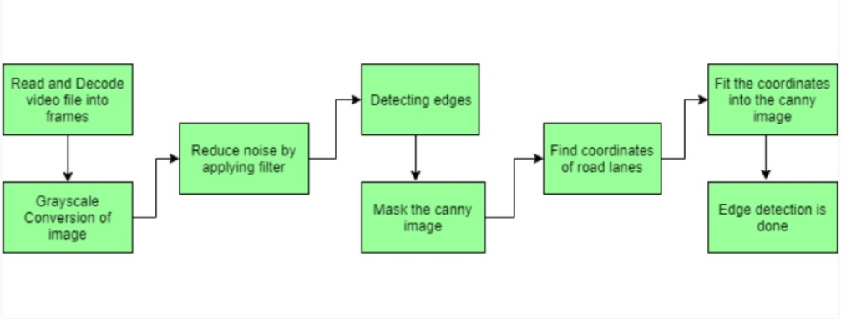
Introduction:
As we are observing 4th industrial revolution technology involving Artificial Intelligence, data-science, and IOT etc are gaining upward pace. An autonomous driving car is one of the most innovative tech in AI, which can perform all the activity were performed by traditional human driving car. But before reaching at the level of human driver it is nessary to train it properly and efficiently. Lane detection is on of the initial step of it.
Steps for lane detection:

Slide 3
Steps for Lane Detection:
Capturing and Decoding Video file: We will use VideoCapture objects to load image file and after capturing video we will decode each frame sequential so that other methods can be applied on frame.
Grayscale conversion of image: The captured image are in RGB format, convert it into Gray-scale. Because processing of frame is faster in single frame, than in multi or three channel coloured image.
Reduce Noise: Even small noise can create false images, therefore it is imperative to apply smoothening before going further. Gaussian filter techniques is used in this process.
Canny Edge Detector: It computes gradient in all the direction of blurred image and traces the edges of large change in intensity.
Region of Interest: This step is to take into account only region covered by the road lane. A mask is created here, which of the same dimension as our road image. Furthermore, the BITWISE operation is performed at each pixel between canny image and mask image. It ultimately masks the canny image and the show the region of interest traced by the polygonal contour of the mask.
Hough Line Transform: It is a transform used to detect the straight line. The Probabilistic Hough Line Transform is used in lane detection, which gives output as extremes detect lines.

